Slide 1


Twitter Airline Sentiment Analysis
Web and Social Analytics Course Project
Group 3
Rafia Fasih
Varun Milind Joshi
Safoora Naureen
Rishitha Reddy Chinnareddy gari

Slide 2
Introduction & Business Context
In the age of social media, understanding public sentiment is invaluable.
Twitter, as a microblogging platform, provides a rich source for sentiment analysis.
The airline sector relies heavily on advanced sentiment analysis for real-time monitoring of passenger comments.
This dependence is crucial for enhancing customer experience and effective crisis management.
The strategic use of sentiment analysis techniques is pivotal for airlines to maintain a competitive edge in the dynamic and competitive industry landscape.

Slide 3




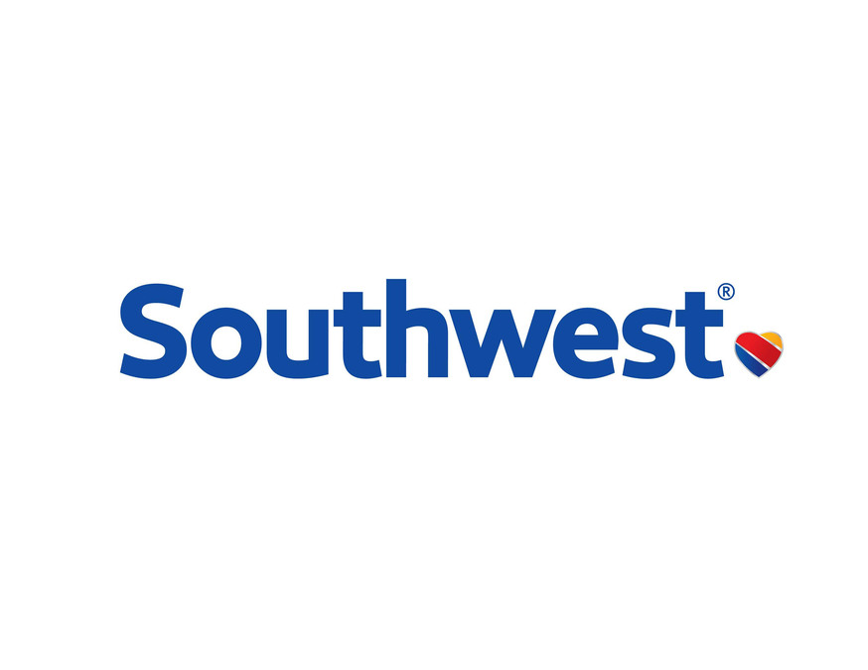

Problem Statement & Objective
Problem Statement:
Limited Real-Time Insight: The airline industry faces challenges in gaining real-time insights into passenger sentiments, hindering the ability to promptly address concerns and capitalize on positive feedback.
Objectives:
Conduct Comprehensive Exploratory Data Analysis (EDA):
Perform in-depth EDA on the dataset to uncover patterns, trends, and correlations between sentiment, geographic variations, and temporal metrics.
2. Implement Sentiment Analysis:
Develop and implement sentiment analysis techniques for real-time monitoring of passenger comments on social media platforms.
Notes:
• Data Description and Source • Research Questions • Methodology (including any data cleaning) • Results and Discussion • Conclusions

Slide 4
What does it mean for business?
Customer Experience Enhancement: Performing sentiment analysis on airline tweets enables businesses to gain valuable insights into customer sentiments, allowing them to proactively address issues, enhance overall customer experience, and build loyalty. Brand Reputation Management: Actively manage and respond to sentiments on social media for maintaining a positive public image. Operational Efficiency: Understanding customer sentiments allows airlines to optimize their operations by identifying pain points and streamlining processes, leading to increased operational efficiency and cost-effectiveness. Competitive Positioning: Leveraging sentiment analysis insights provides a competitive advantage by enabling airlines to differentiate themselves based on customer satisfaction, attracting new customers, and retaining existing ones in a highly competitive industry.
Crisis Preparedness: Use sentiment analysis as a tool for helping airlines anticipate and manage potential PR crises by identifying emerging negative sentiments and allowing for timely and effective communication strategies. Data-Driven Decision-Making: Support business decisions with quantitative insights from sentiment analysis for continuous improvement and innovation.

Slide 5
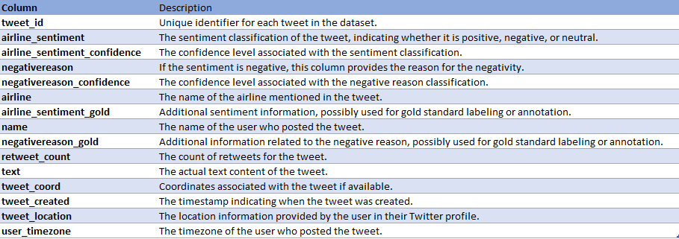
Data Description and Source
Data source-https://www.kaggle.com/datasets/crowdflower/twitter-airline-sentiment
Description- The dataset comprises tweets pertaining to airline experiences, classified into three sentiment classes: positive, negative, and neutral. It includes key information such as tweet text, sentiment labels, and details about the respective airlines. Notably, the tweets in this dataset date back to 2015, raising considerations about the relevance of sentiment analysis due to potential shifts in the airline industry's sentiments over time. It has 14640 rows and 15 columns.

Slide 6
Methodology
Data loading
CSV to Pandas
Data exploration
Categorical and numerical columns
Data processing
Missing values
Encoding
Research questions
Additional categorization
Temporal trends
Geographic variations
Null values
Sentiment impact
Model building
Count vectorizor
TFIDF
GloVe
Results & Conclusion

Slide 7
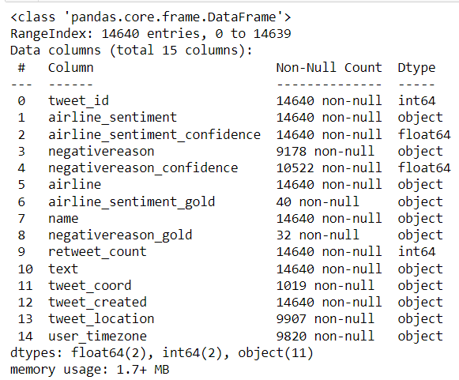
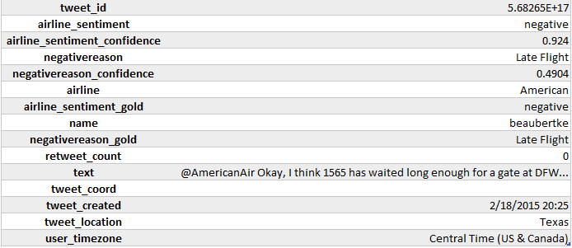
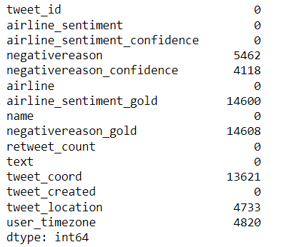
Data Snapshot
Missing data

Slide 8
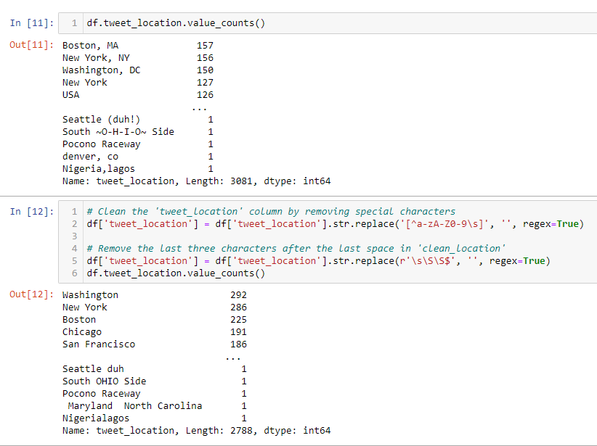
Data processing
Removing excess columns
Modifying the tweet location column
Imputing missing values for tweet_location and user_timezone with ‘Unknown’
Getting tweet_hour and tweet_date from tweet_created column

Slide 9
Research Questions
Sentiment Distribution: What is the distribution of sentiment (positive, negative, neutral) within tweets discussing airline experiences?
Airline Performance: How do different airlines compare in terms of sentiment, revealing patterns of consistently positive or negative customer feedback?
Temporal Trends: Are there discernible temporal trends in sentiment, such as seasonality or evolving sentiments over time, offering insights into changing customer perceptions?
Key Topics: What are the predominant topics or issues highlighted in negative tweets concerning airlines, shedding light on the common concerns among customers?
Sentiment Impact: To what extent does sentiment correlate with key engagement factors like retweets, providing an understanding of the impact of sentiment on social media engagement?
Geographic Variation: Is there noticeable geographic variation in sentiment, with specific regions demonstrating more positive or negative sentiments toward airlines, offering insights into regional perceptions and experiences?

Slide 10
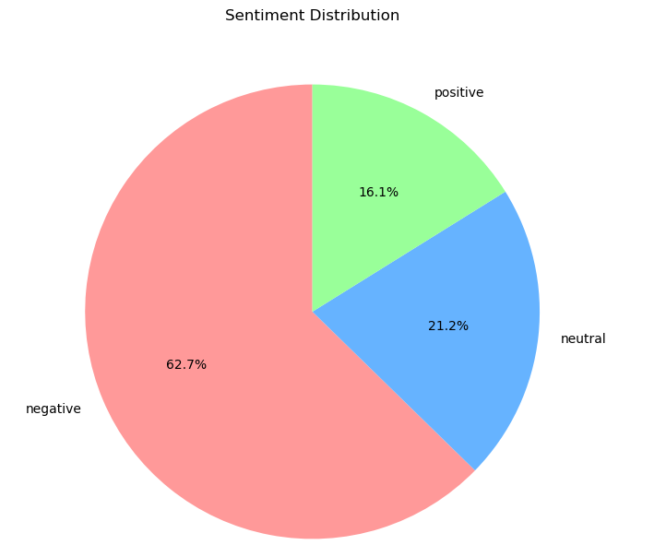
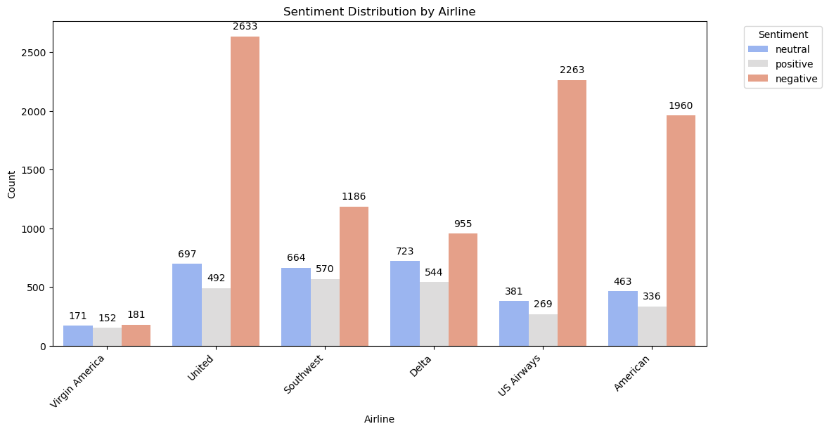
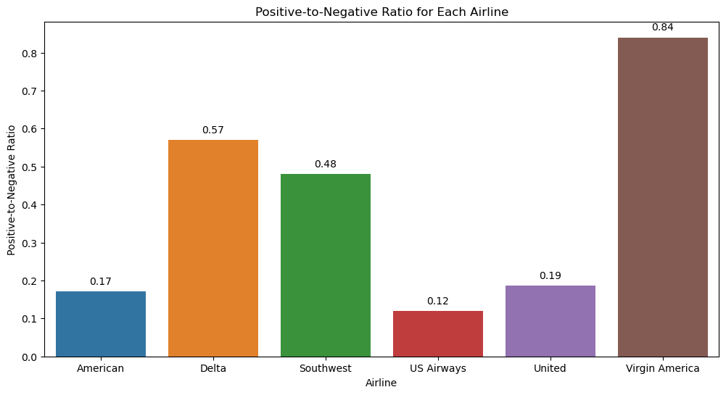
Sentiment Distribution and Airline Performance

Slide 11
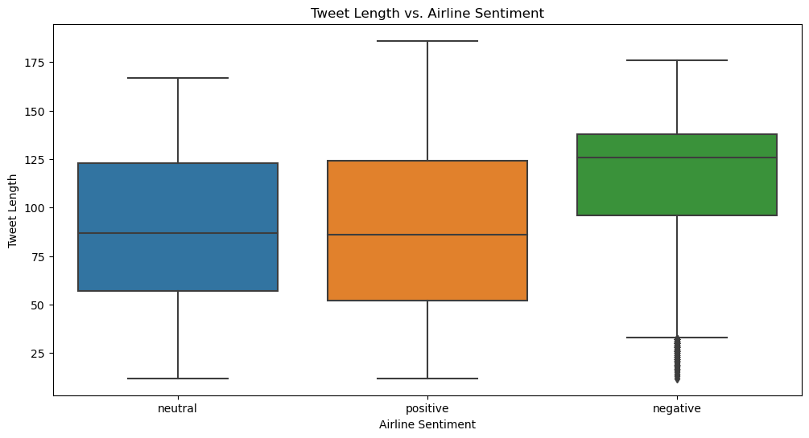
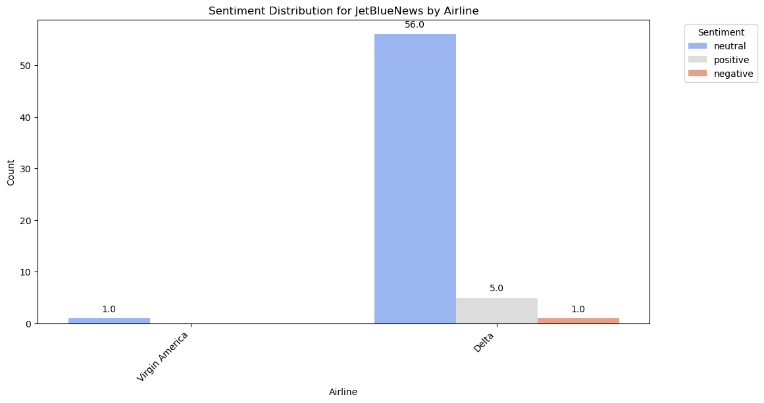
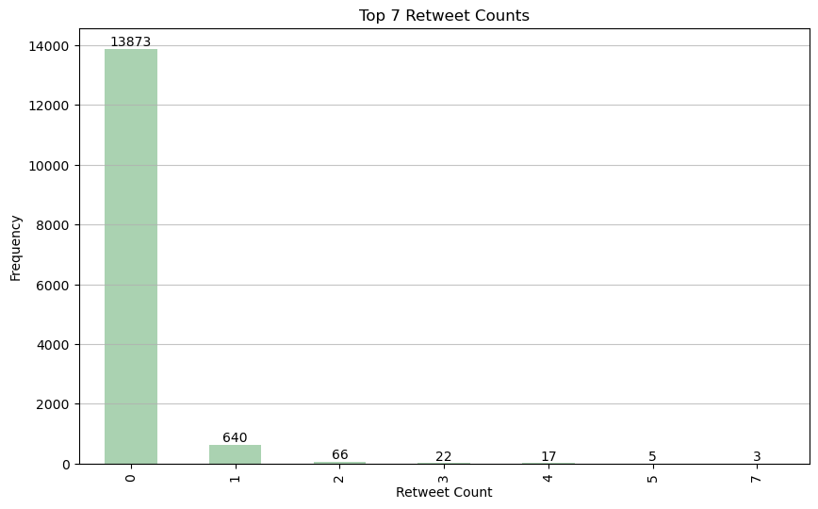
Impact of Tweet Length on Sentiment
Analysis of user with highest number of tweets

Slide 12
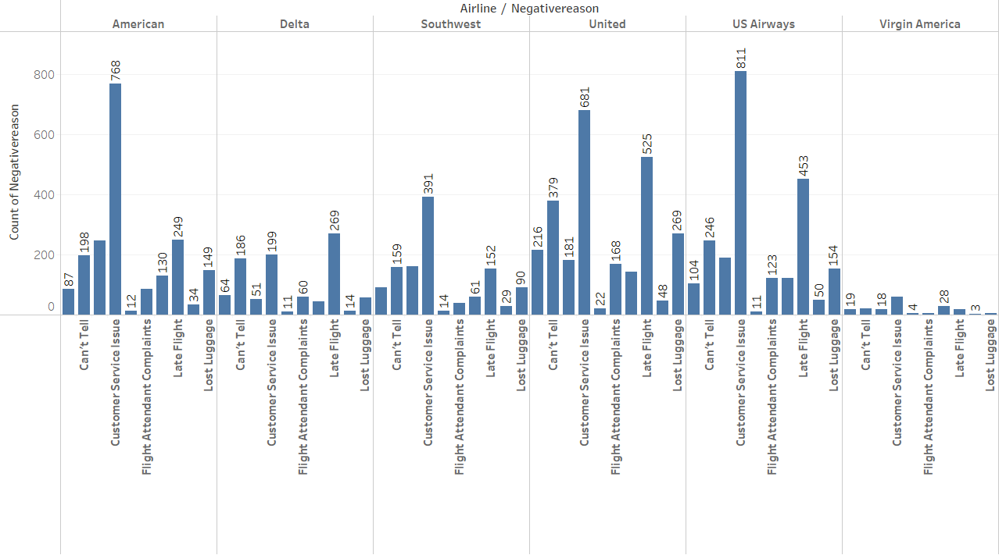
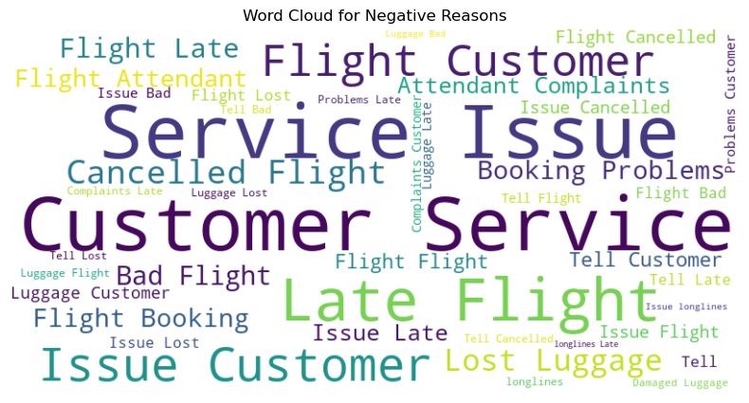
Notes:
Bad flight, Cancelled flight, Customer service issue, damaged luggage, flight attendant complaints, flight booking problems, late flight, lost luggage, longlines

Slide 13
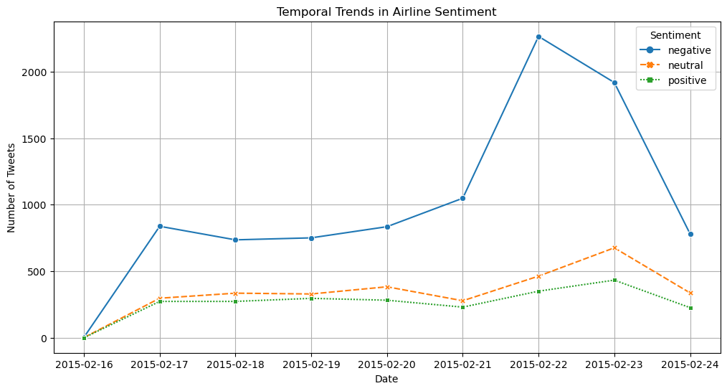
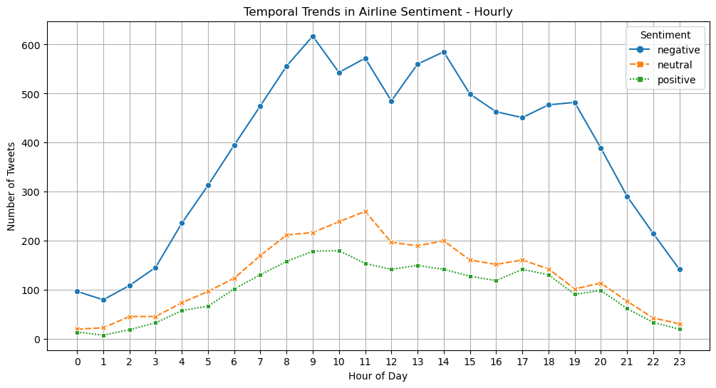
Temporal trends

Slide 14
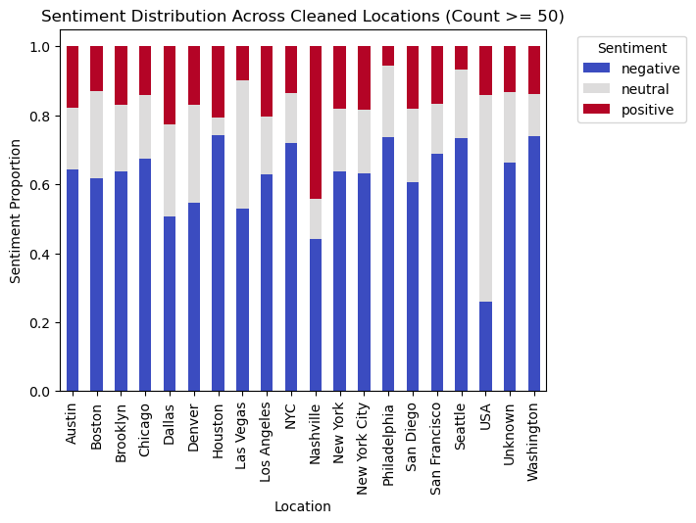
Geographic Variations
Notes:
Houston, Nahsville, Philly

Slide 15
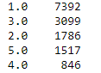
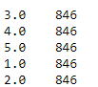
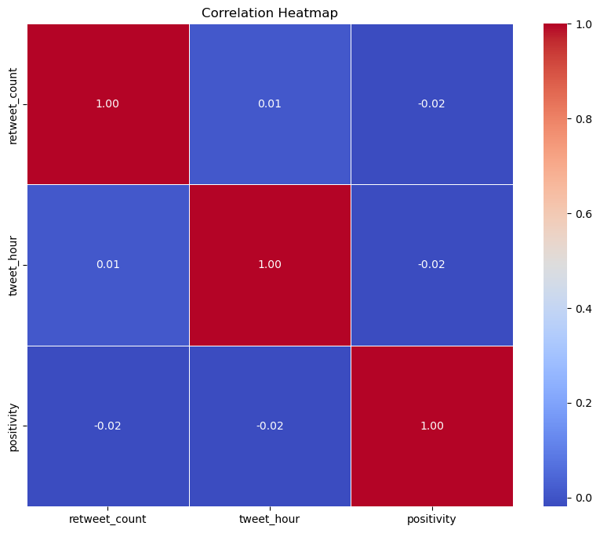
Categorisation & Sentiment Impact
Created new column as Positivity(1 to 5) to have 5 standards rather than just the 3 (positive, negative, neutral) using confidence level
Balanced the dataset to have equal distribution of positivity
Conducted correlation analysis of positivity and other numerical columns

Slide 16
Removing Stop words
Splitting the dataset (80:20)
NLP Methods
Count Vectorisor: 62.1%
TFIDF: 61.8%
GloVe: 62.4%
Grid Search and Cross Validation
Performance Metrics
Prediction
C: 1
Kernel: rbf
Confusion matrix
SVM
CV: 5
Model Building for Sentiment Analysis

Slide 17
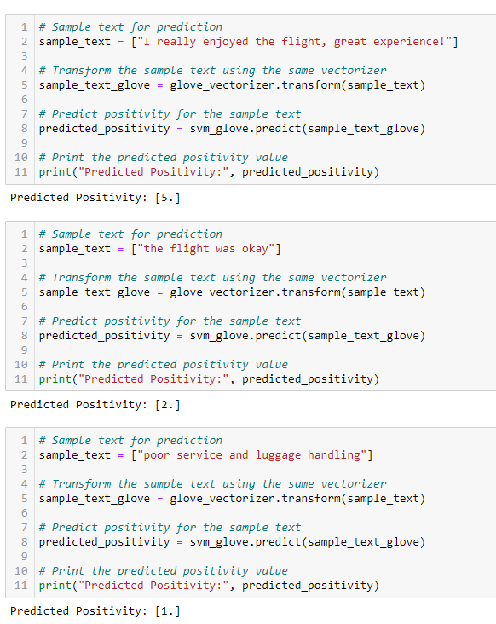
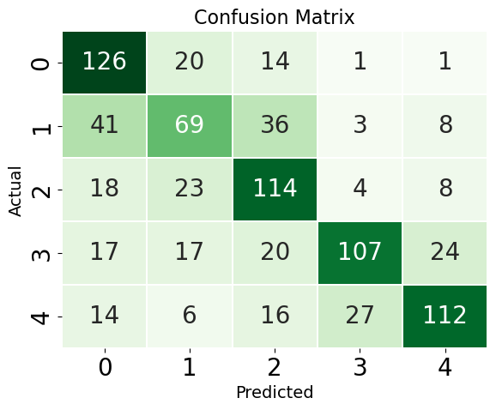
Results and Predictions

Slide 18
Conclusions & Recommendations
Dominance of Negative Sentiments: Individuals expressing their opinions online, particularly on platforms like Twitter, tend to share negative reviews more frequently than neutral or positive ones.
Negative sentiment ratio is higher for US Airways and American Airlines despite the higher count for United Airlines
Addressing negative sentiments in real-time can lead to improved customer satisfaction and loyalty
Limitations: The data is of 2015 which cannot be applicable in the Post COVID Era; Balanced dataset also limited the size of it in entirety.
Recommendations: Based on our findings, airlines should actively engage with customers on social media, promptly addressing concerns and showcasing positive experiences. Utilizing the developed real-time sentiment analysis tool can enhance targeted marketing efforts, leading to an improved brand perception.

